Slide 1
Employee Data Analysis using Excel
Student Name: K. Divya
Register No: 312208473
Department: B. Com (Commerce)
College: Chellammal women's College

Slide 2
PROJECT TITLE
Employee Performance Analysis
using Excel

Slide 3

AGENDA
Problem Statement
Project Overview
End Users
Our Solution and Proposition
Dataset Description
Modelling Approach
Results and Discussion
Conclusion

Slide 4

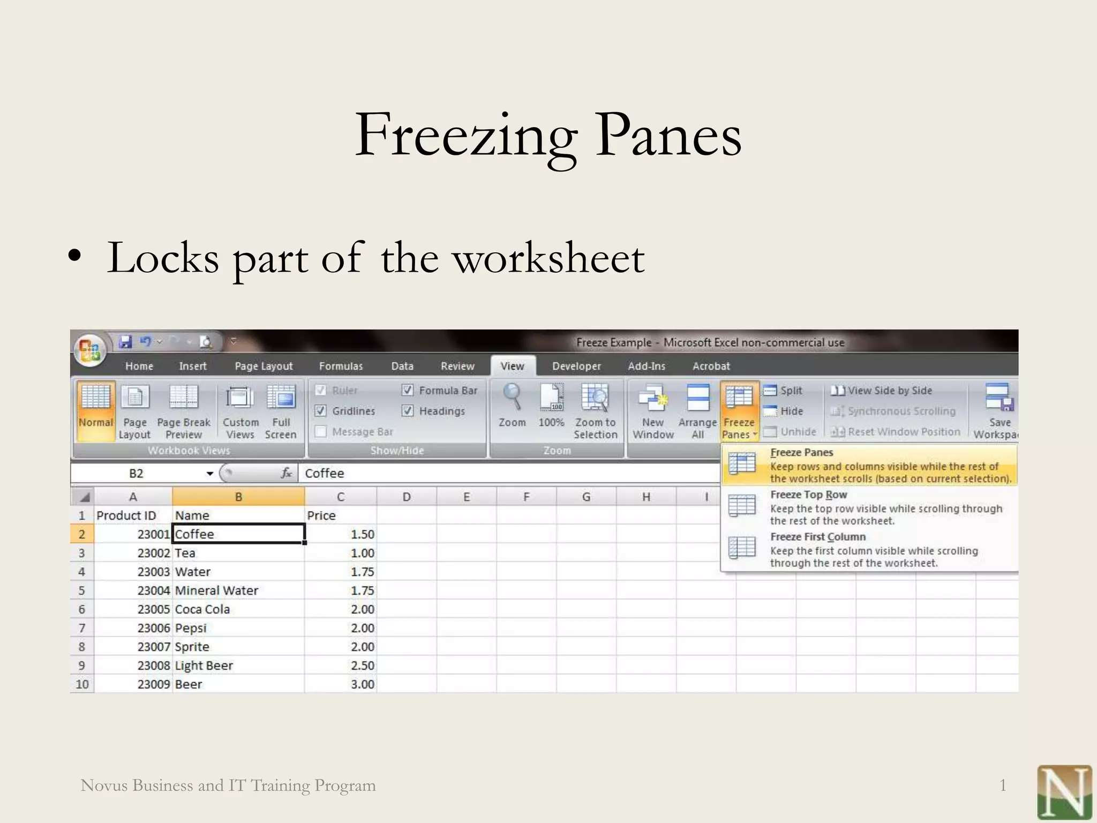

Slide 5

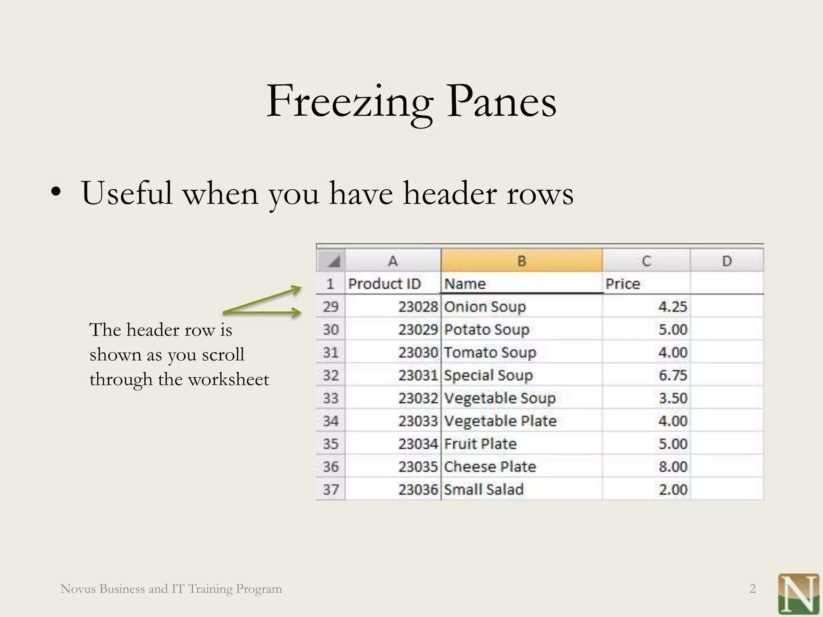

Slide 6
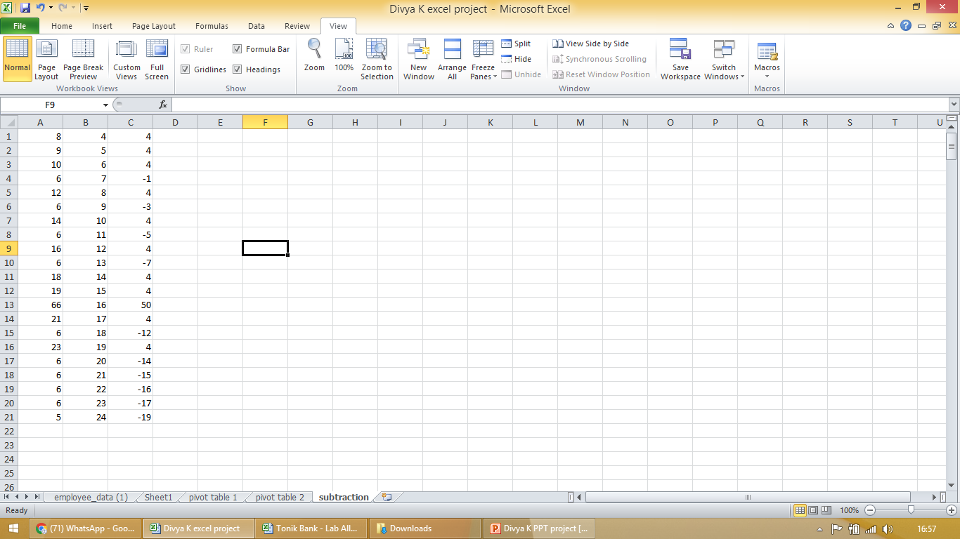
OUR SOLUTION AND ITS VALUE PROPOSITION
SUBRACTION

Slide 7
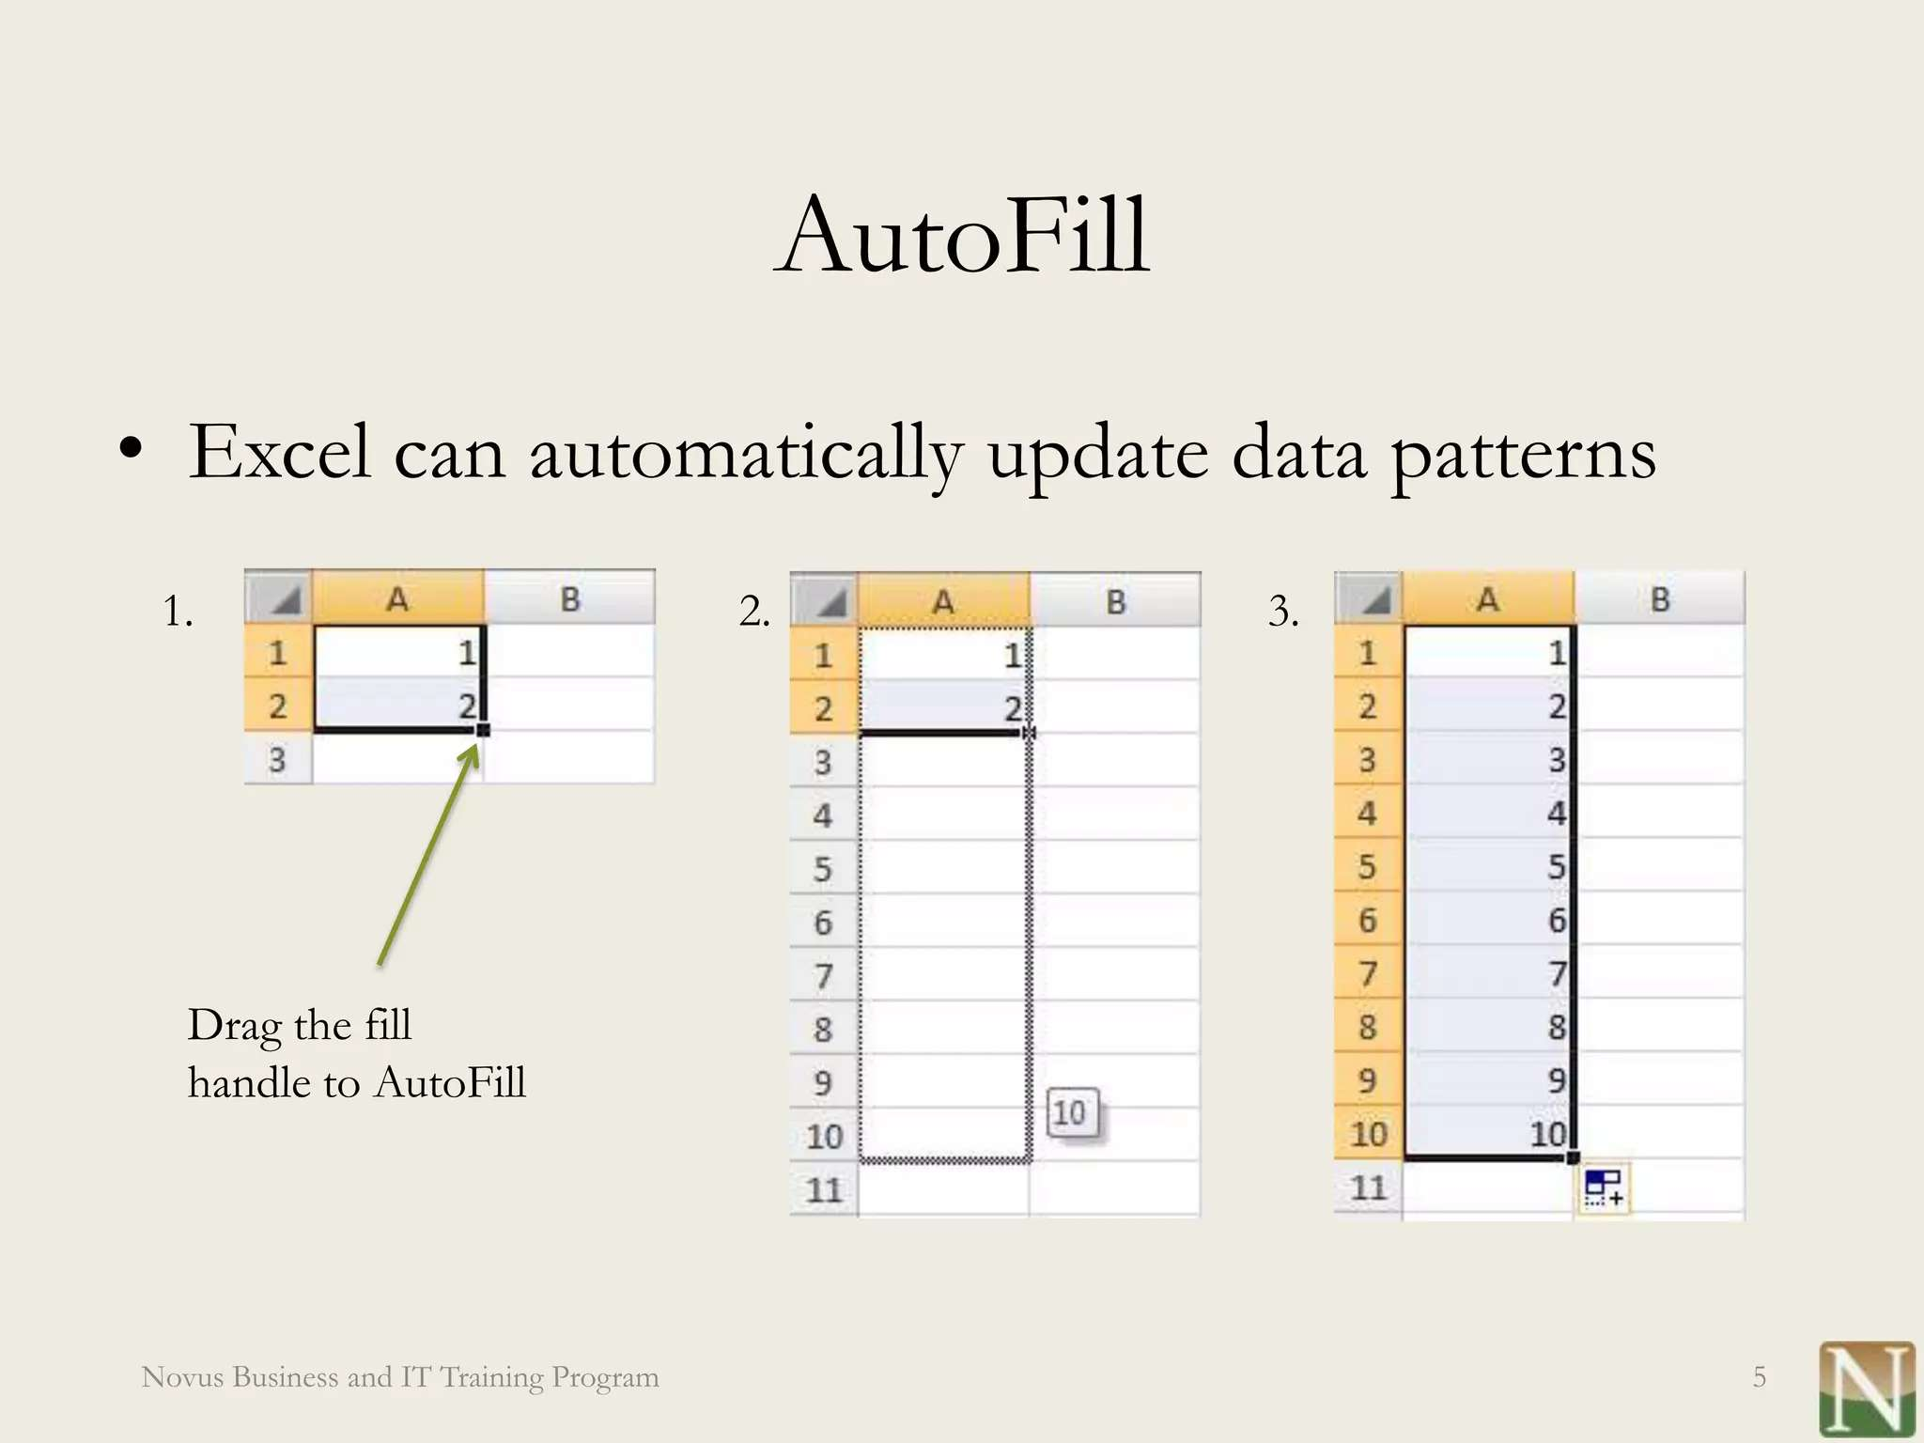
MODELLING

Slide 8
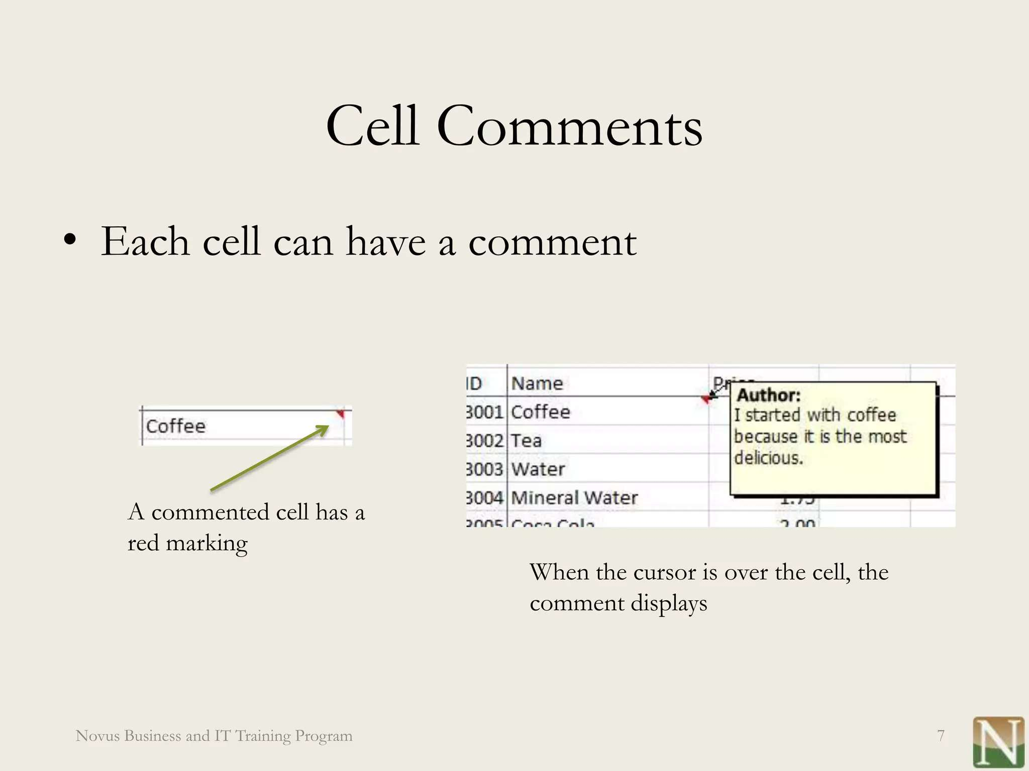

Slide 9
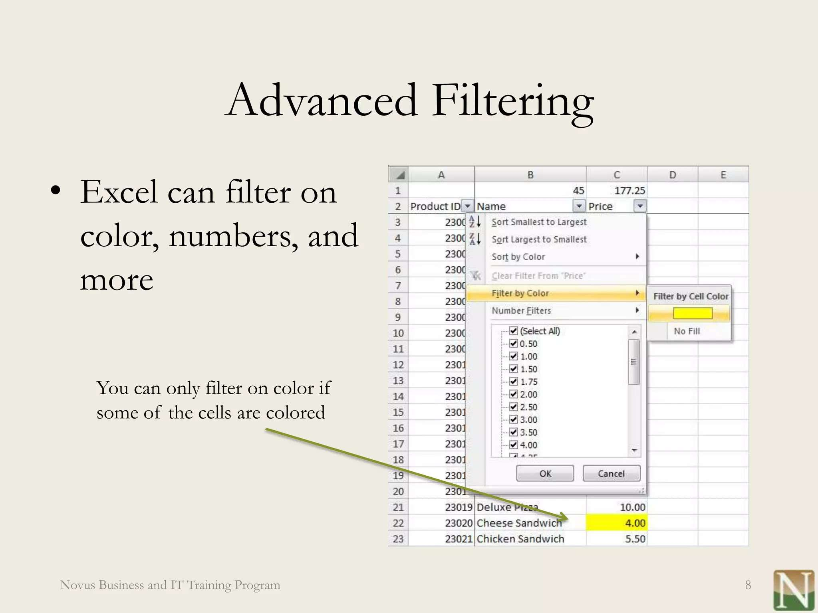

Slide 10
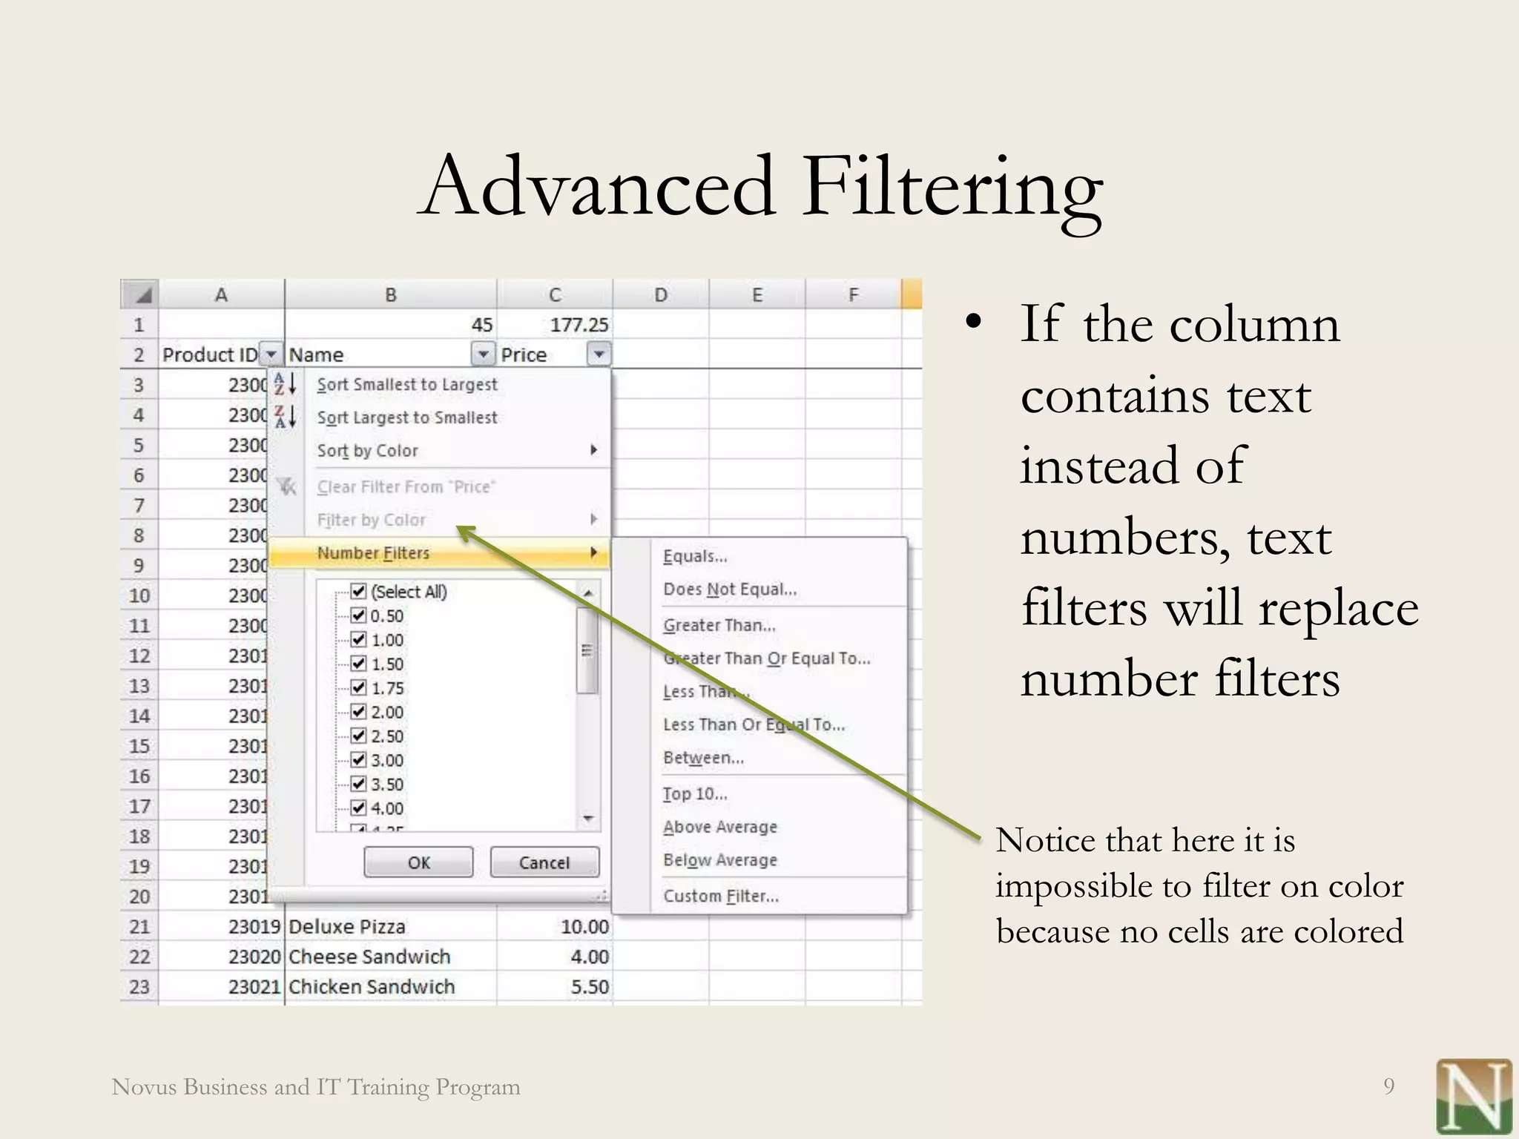
RESULTS

Slide 11
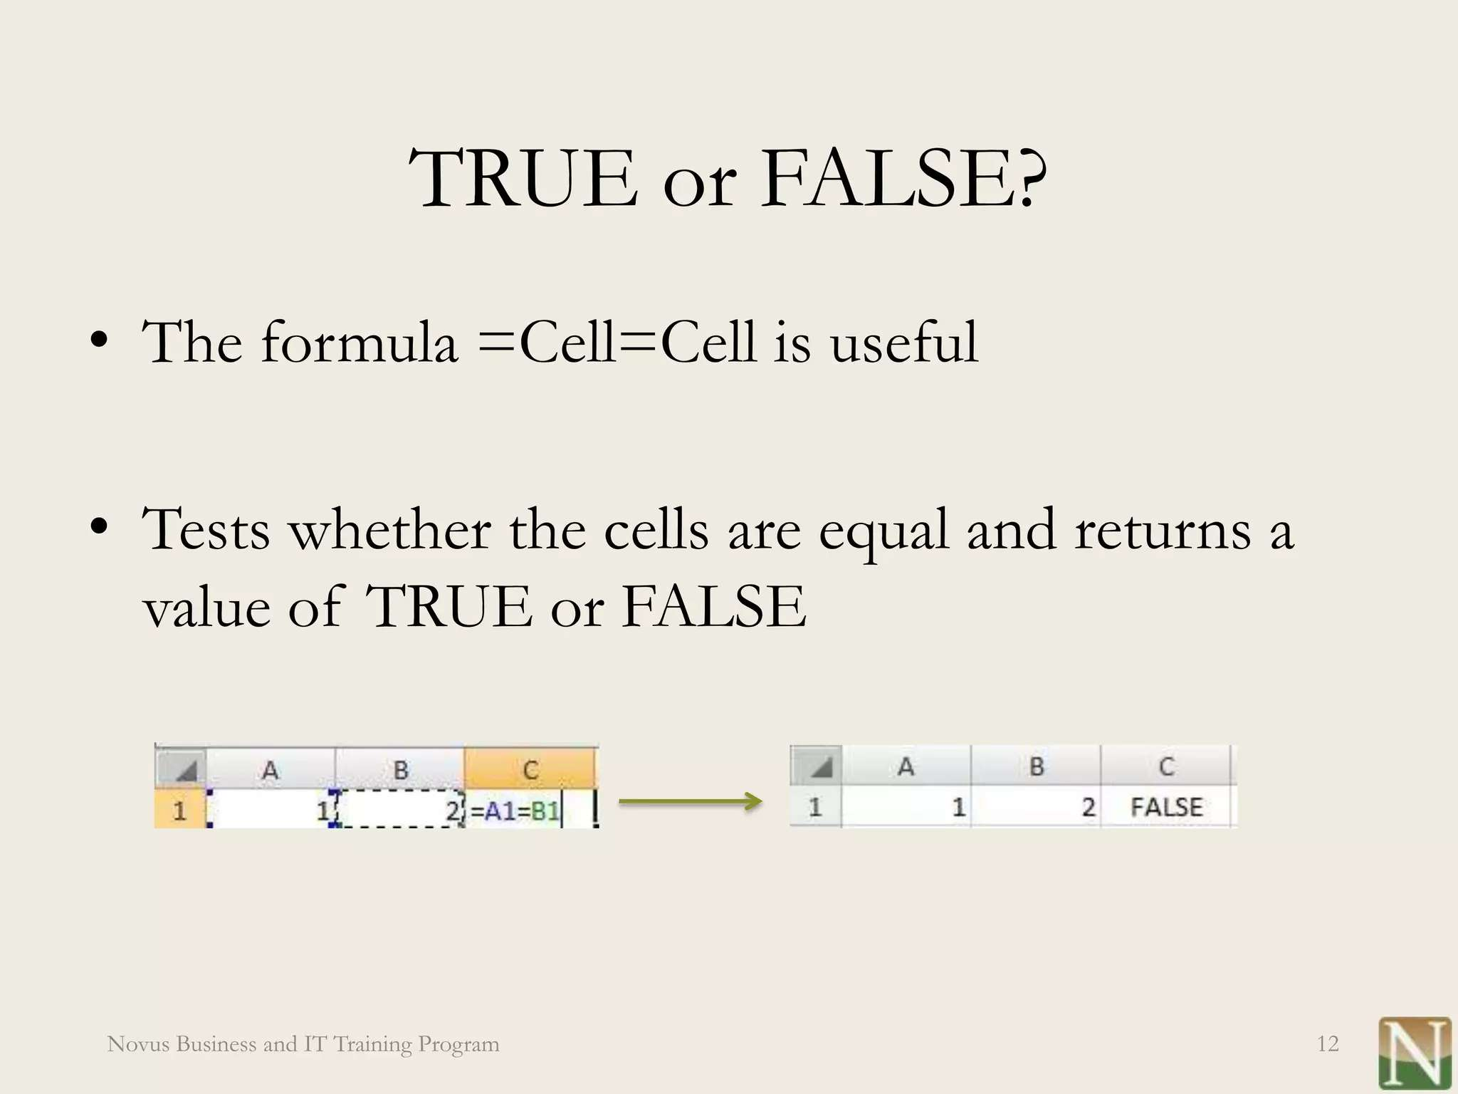

Slide 12
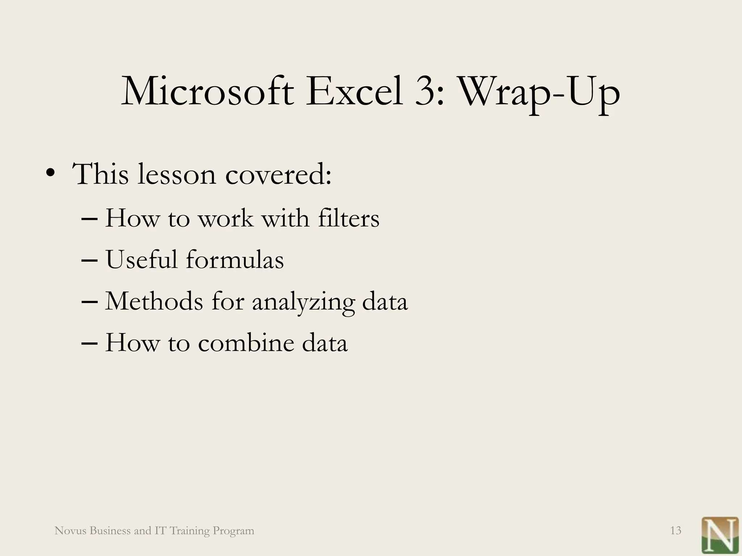
CONCLUSION

Slide 13


